Slide 1
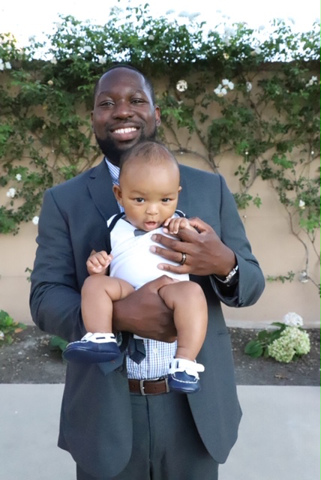
Obinna Amobi
EMPLOYER / Mercy Housing Northwest
PLANNING FOCUS / Real Estate/Housing
MOST INTERESTING PROJECT AS A PLANNER / Building 9, Historic Renovation of a vacated former military barracks into 148 units of affordable housing – I worked on the pre-development and construction budgeting for this project
EDUCATION /
University of Washington (2011 – 2013) MUP Candidate
UCLA (2005 – 2009) Geography/Urban Studies, BA
YEARS PLANNING / 5
WHY I PURSUED PLANNING AS A PROFESSION / My focus since undergrad has been on affordable housing. Planning and real estate seemed like a well-rounded path to be industry adjacent since most schools lack a directed educational focus on affordable housing.
PAST WORK EXPERIENCE /
Mercy Housing Northwest (2015 – present)
Heartland LLC, Research Analyst (2013 – 2015)
Previously Interned at: SKIDPDA, Seattle Housing Authority, Goodman Real Estate.

Slide 2
David Blum, AICP
EMPLOYER / Montgomery Gulf Corporation
PLANNING FOCUS / Transit Oriented Development, Real Estate Development
MOST INTERESTING PROJECT AS A PLANNER /
Northgate Transit Oriented Development Project
EDUCATION / UW, MUP (’76); The Wharton School, University of Pennsylvania, BS in Economics (’74)
YEARS PLANNING / 39
WHY I PURSUED PLANNING AS A PROFESSION / As a
person interested in the built environment and land use, I found planning to be a good place to work in a variety of interesting settings.
PAST WORK EXPERIENCE / Nonprofit sector in affordable housing; Native American tribe in economic development

Slide 3
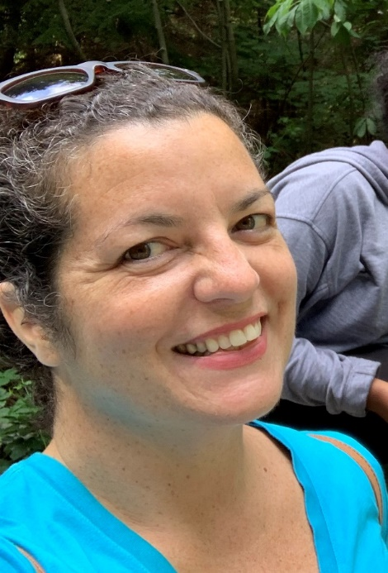
Shelley Bolser, AICP
EMPLOYER / City of Seattle Department of Construction and Inspections (SDCI)
PLANNING FOCUS / Urban design and current planning
MOST INTERESTING JOB AS A PLANNER / I love seeing projects I’ve worked on that include active indoor and outdoor public community spaces (ex. 400 Fairview Ave N in SLU, Via6 in Denny Triangle, Pike Motorworks Capitol Hill
EDUCATION / UW, MUP and Urban Design Certificate (‘03); UW, BA (‘02)
YEARS PLANNING / 14
WHY I PURSUED PLANNING AS A PROFESSION/ Passionate about the potential for urban design to shape how we live together in cities. We need to create different spaces and buildings that encourage community.
PAST WORK EXPERIENCE / Planner work in City of Seattle, Mercer Island, Kirkland, and some private sector consulting. Sewer and water maintenance in Kent and Kirkland (cities near Seattle).

Slide 4
Steve Butler , FAICP
EMPLOYER / MRSC (Municipal Research & Services Center)
PLANNING FOCUS / Comprehensive and subarea planning, innovative implementation techniques (both regulatory and non-regulatory), urban design, and public engagement
MOST INTERESTING PROJECT AS A PLANNER / Station area planning for two LRT stations in SeaTac; City of SeaTac/Sea-Tac Airport Interlocal Agreement; Cape Elizabeth (ME) Greenbelt Plan
EDUCATION / University of Wisconsin (Madison), MS in Urban & Regional Planning; St. Lawrence University (Canton, NY), BA in Sociology
YEARS PLANNING / 30+
WHY I PURSUED PLANNING AS A PROFESSION / Combines a lot of my interests – improving the built environment, urban design, and public engagement; had a great undergraduate professor who got me interested in the field.
PAST WORK EXPERIENCE / City of Milwaukie, OR; City of Mill Creek; City of SeaTac; plus public and private sector planning in Maine and Wisconsin

Slide 5
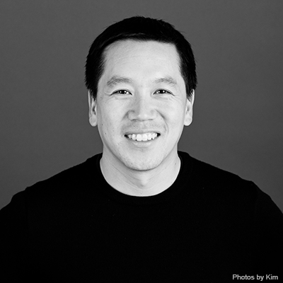
Michael Chen
EMPLOYER / Mackenzie
PLANNING FOCUS / Current Planning, Development and Entitlement
MOST INTERESTING PROJECT AS A PLANNER / Reviewing and permitting the Redmond Ridge and Trilogy at Redmond Ridge UPD’s. Being able to travel to different states along the west coast to entitle projects.
EDUCATION / Wester Washington University, BA Environmental Planning & Policy (1998) University of Washington, Certificate in Commercial Real Estate (2013-2014)
YEARS PLANNING / 21
WHY I PURSUED PLANNING AS A PROFESSION /
To help shape communities and be involved in a wide variety of development.
PAST WORK EXPERIENCE / City of Mercer Island, King County DPER (DDES), Core Design Inc., Centre Pointe Consultants

Slide 6
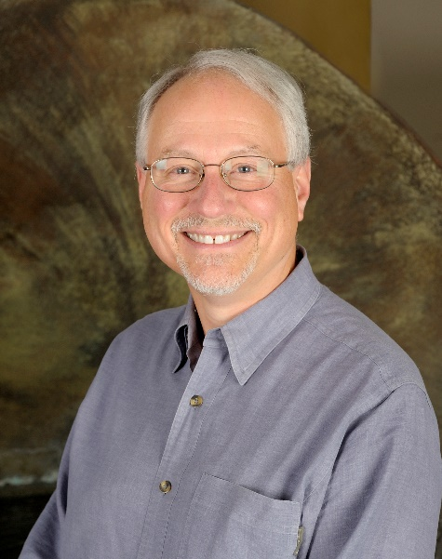
Richard Conlin
EMPLOYER / Conlin Columbia
PLANNING FOCUS / Affordable Housing; Sustainable Development; Food Policy; Resilience/Emergency Management; Community/Neighborhood Planning; Local Government; Policy Development/Implementation
MOST INTERESTING PROJECT AS A PLANNER / Stewarding 37 Neighborhood Plans to adoption and implementation; writing Food Policy Plans for Tacoma, Auburn, Seattle, and Riverside, CA
EDUCATION / MA Poli Sci; BA History
YEARS PLANNING / Depends on how broadly you define planning… up to 46
WHY I PURSUED PLANNING AS A PROFESSION / My passion and profession is community/sustainable development
PAST WORK EXPERIENCE / Seattle City Council; Publisher, YES! Magazine; Director, Community and Environment Department, Metrocenter YMCA; developer, consultant, and adjunct faculty; Ingham County, MI, Board of Commissioners

Slide 7
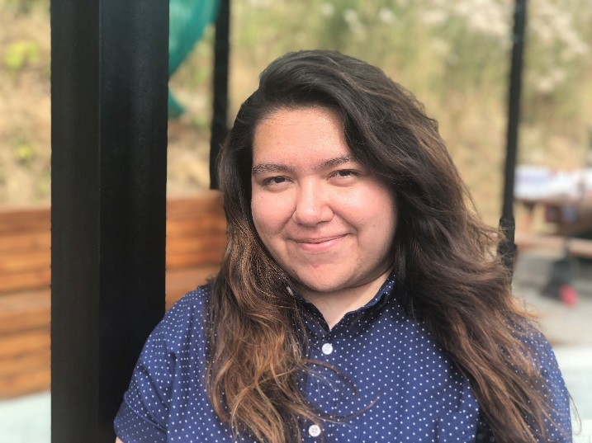
Sara Cubillos
EMPLOYER / Seattle Public Utilities – Strategic Advisor in the Drainage & Wastewater Division
Emerging Leader – Capitol Hill Housing PDA Board Seattle Office of Planning and Community Development
PLANNING FOCUS / Environmental Justice, Movement building, equitable engagement, creative facilitation, infrastructure investments
MOST INTERESTING PROJECT AS A PLANNER / Equity & Environment Initiative
EDUCATION / UW MUP – Real Estate specialization & Historic Preservation Certificate, Seattle U BA in Public Administration
YEARS PLANNING / 5 years
WHY I PURSUED PLANNING AS A PROFESSION / Creating visibility of invisible systems like infrastructure
PAST WORK EXPERIENCE / Office of Sustainability & Environment – Equity & Environment Program Coordinator
SPU – Environmental Justice & Service Equity Intern

Slide 8
Marty Curry AICP
EMPLOYER / UW, Urban Design & Planning Affiliate Faculty; Curry Consulting
PLANNING FOCUS / Community planning, civic engagement, infrastructure planning, sustainability
MOST INTERESTING PROJECT AS A PLANNER / Community visioning projects (e.g. Lake City); achieving community- city (and often student) partnerships
EDUCATION / UW, MUP; Indiana University, BA in Spanish and Political Science
YEARS PLANNING / 30+
WHY I PURSUED PLANNING AS A PROFESSION / I strongly believe that planning, politics, and people are integral to creating a more balanced, sustainable community (The 3 P’s of planning).
PAST WORK EXPERIENCE / City of Seattle, Planning Commission Director; consulting with non-profits, foundations and local government, and of course teaching

Slide 9
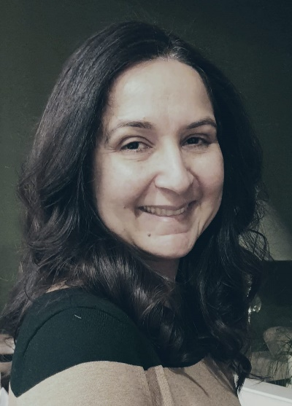
Minnie Dhaliwal
EMPLOYER / City of Tukwila
PLANNING FOCUS / Land use-current and long-range planning; urban design; community engagement
MOST INTERESTING JOB AS A PLANNER / My favorite part of all the wide variety of projects I have worked on is the community engagement. Establishing a community connectors program to reach to diverse community members as part of the comprehensive planning update process was very interesting.
WHY I CHOSE PLANNING AS A PROFESSION / I grew up in Chandigarh, a master planned city by Le Corbusier; was intrigued by cities in general particularly the difference between traditional Indian cities and my hometown.
EDUCATION / B. Arch- India (87-92); Master of Urban Planning UW (94-97)
YEARS PLANNING / 25
PAST WORK EXPERIENCE / Planning Manager, City of Tukwila (2007-present); Senior Planner, City of Tukwila (2000-2007); Associate Planner, City of Federal Way (1996-2000)

Slide 10
Nancy Eklund, AICP
EMPLOYER / Community Attributes
PLANNING FOCUS/ Comprehensive planning, health and the built environment.
MOST INTERESTING PROJECT AS A PLANNER / Too many to say – the ones that are the most fun are the thorny ones that generate strong opinions
EDUCATION / UW Masters Program (near-MUP), Macalester College, St. Paul, MN, BA in Geography
YEARS PLANNING / 25+
WHY I PURSUED PLANNING AS A PROFESSION / I was a geography major and always loved knowing why people live where they do – what was special about those places. I wanted to be a part of shaping those decisions.
PAST WORK EXPERIENCE / The City of Puyallup; private consulting; Washington and Montana local government

Slide 11
Nicole Faghin, MCP, JD, LEED AP
EMPLOYER / Washington Sea Grant
PLANNING FOCUS / Shoreline and Coastal Management
MOST INTERESTING PROJECT AS A PLANNER /
How do we address sea level rise as planners? What is the intersection between erosion and sea level rise and actions to take?
EDUCATION / MIT, MCP (‘86); Northeastern School of Law – JD (‘87); UW, BA in Political Science (‘81)
YEARS PLANNING / 25+
WHY I PURSUED PLANNING AS A PROFESSION /
I was interested in human interface with the environment and over the years that became human/built interface with the marine/shoreline environment.
PAST WORK EXPERIENCE / Reid Middleton (18 years); AECOM (1.5 years); 3 years in law (way back at the beginning…)

Slide 12
Ted Gage, AICP
EMPLOYER / Planning consultant
Community comprehensive planning, tourism
PLANNING FOCUS / Development, tribal planning, interagency coordination.
MOST INTERESTING PROJECT AS A PLANNER/ Training elected and appointed officials statewide during the years in which I managed the state’s Short Course on Local Planning for the Department of Commerce
EDUCATION / UW, PhD (‘83); UW, MUP (‘81); Middlebury College, BA (‘69)
YEARS PLANNING / 35+
WHY I PURSUED PLANNING AS A PROFESSION /
Always interested in the dynamics of community development.
PAST WORK EXPERIENCE / Washington State Department of Commerce; Clallam County EDC; Samish Indian Nation; Shoalwater Bay Indian Tribe; Eldred & Associates.

Slide 13
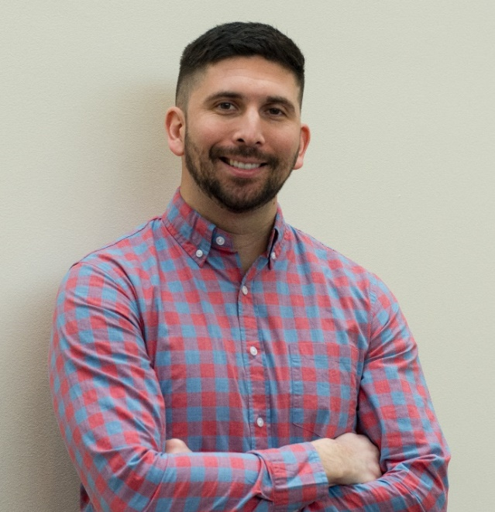
Brandon Gonzalez, AICP
EMPLOYER / Alta Planning + Design
PLANNING FOCUS / Long-range urban planning (e.g., comprehensive and small area planning), placemaking, and active transportation.
MOST INTERESTING PROJECT AS A PLANNER /
Planning context lead for the Downtown Dallas station as part of the Dallas to Houston high speed rail project.
Education/ Master of City and Regional Planning, University of Texas; Bachelor of Arts in Political Science, Texas Tech University
YEARS PLANNING / 10
WHY I PURSUED PLANNING AS A PROFESSION /
I’ve always been attracted to and fascinated with cities and our urban environment. Our space and urban framework builds creativity, facilitates innovation and helps us lead healthier, more sustainable lives!
PAST WORK EXPERIENCE / Project Manager in the Dallas office of Freese and Nichols, Inc., a large engineering and planning consulting firm based in Texas.

Slide 14
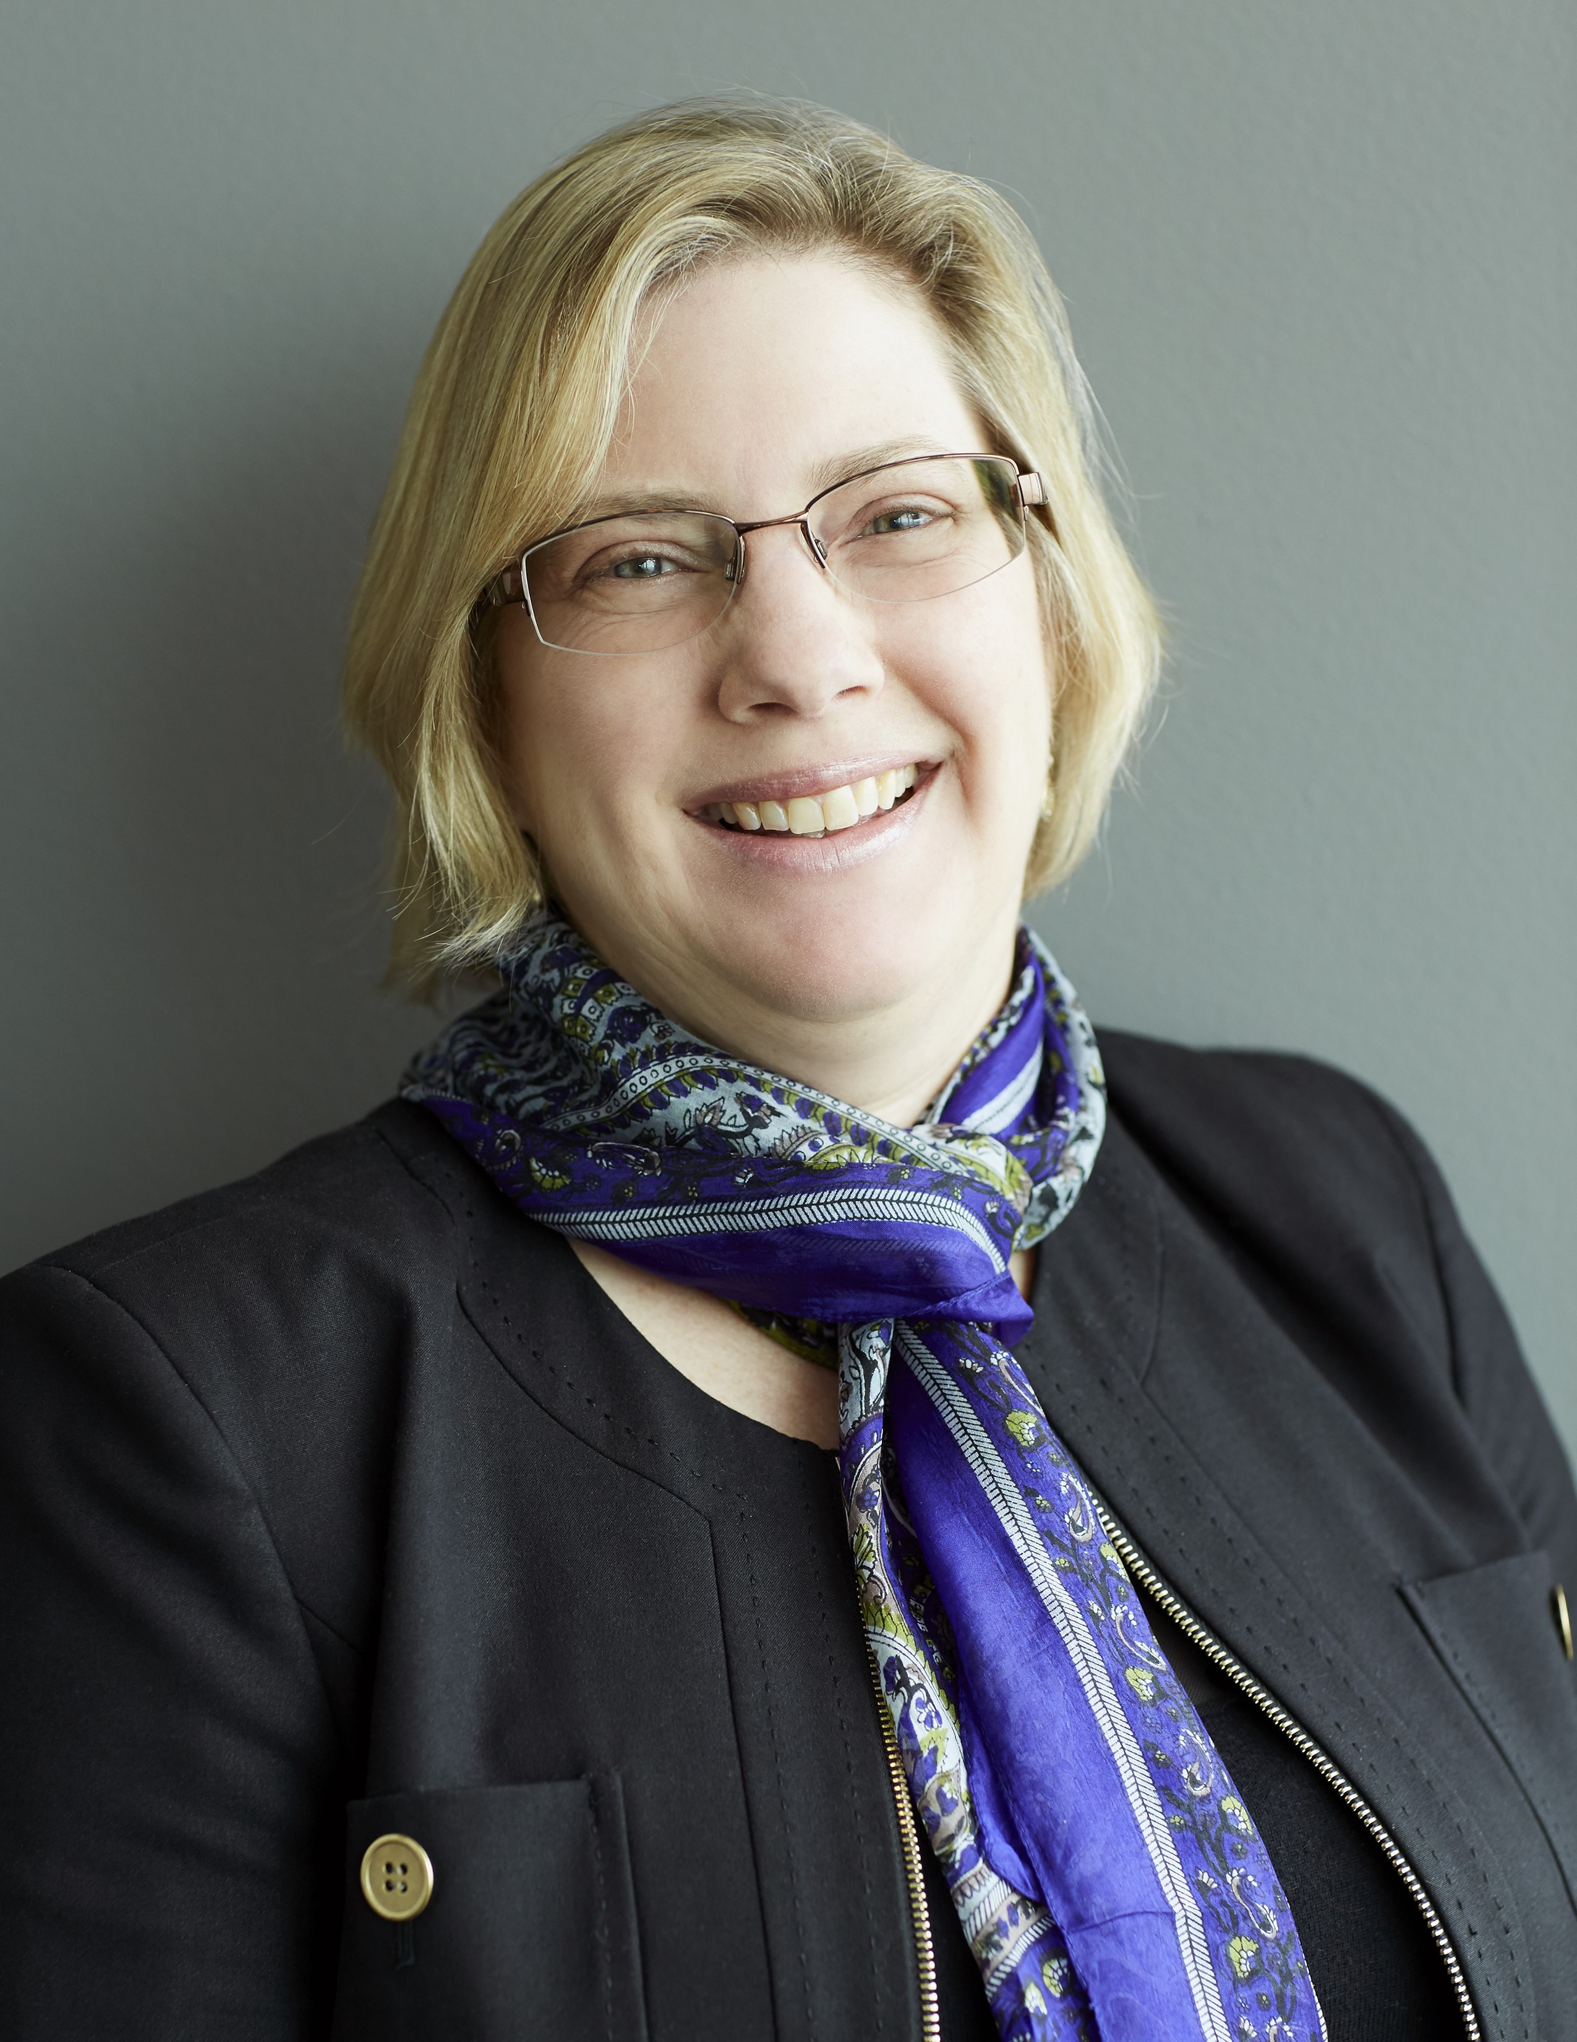
Lisa Grueter, AICP
EMPLOYER / BERK Consulting, Inc.
PLANNING FOCUS / Comprehensive Planning, Environmental Planning, Capital & System Planning
MOST INTERESTING PROJECT AS A PLANNER / I like them all! If I had to choose … county-city planning efforts and plan implementation strategies.
EDUCATION / Master of City Planning, Berkeley; BA Social Ecology, UC Irvine
YEARS PLANNING / 30
WHY I PURSUED PLANNING AS A PROFESSION / Interest in affordable housing and environmental conservation. Started as a kid with summer school class called “the City”.
PAST WORK EXPERIENCE / ICF Jones & Stokes, City of Renton, City of Sumner, Private Practice in California

Slide 15
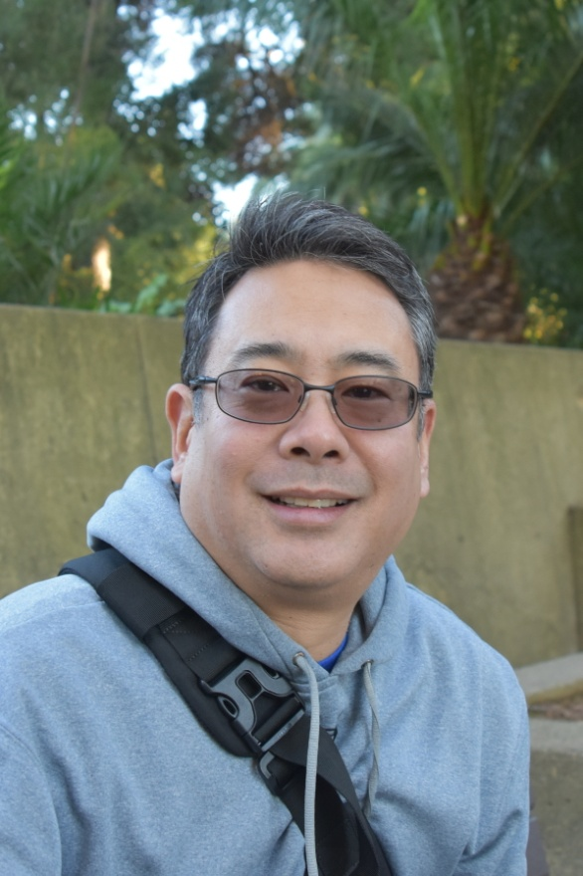
Steve Hamai
EMPLOYER / Seattle Public Utilities
PLANNING FOCUS / Comprehensive Utility Planning, Resiliency, Affordability, Community Engagement, Service Equity
MOST INTERESTING PROJECT AS A PLANNER / Led an effort to build an new operational model to embed race, social justice, and service equity into the fabric of Seattle Public Utilities.
EDUCATION / San Francisco State University, BA Urban Studies
YEARS PLANNING / 20+
WHY I PURSUED PLANNING AS A PROFESSION / Having spent many years in non profit direct services and community organizing, decided that I needed to apply my learning and skills within government to address systemic disparities with a racial equity lens.
PAST WORK EXPERIENCE / Founder and Executive Director, SafeFutures Youth Center; Program Director, Seattle Youth Employment Program; Senior Planner, Human Services Department; Program Director, East Bay Asian Youth Center

Slide 16
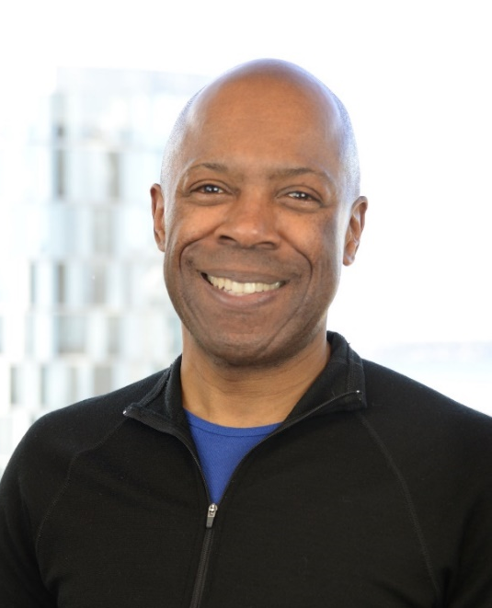
Philip Harris, AICP
EMPLOYER / Washington State Department of Transportation (WSDOT) – Regional Transit Coordination Division
PLANNING FOCUS / Pedestrian and Bicycle Access to high capacity transit, station area planning, transit oriented development, urban design
MOST INTERESTING PROJECT AS A PLANNER / Interstate Avenue MAX Light Rail (Portland) – Station area planning, Charlotte transit planning
EDUCATION / BA – Geography/Regional Development – Bulmershe College/Reading University UK); Masters City & Regional Planning – Georgia Institute of Technology
YEARS PLANNING / 20
WHY I PURSUED PLANNING AS A PROFESSION /
Interest in how communities are designed and work
PAST WORK EXPERIENCE / TriMet (Portland), City of Portland, City of Charlotte, City of Atlanta, City of Bellevue

Slide 17
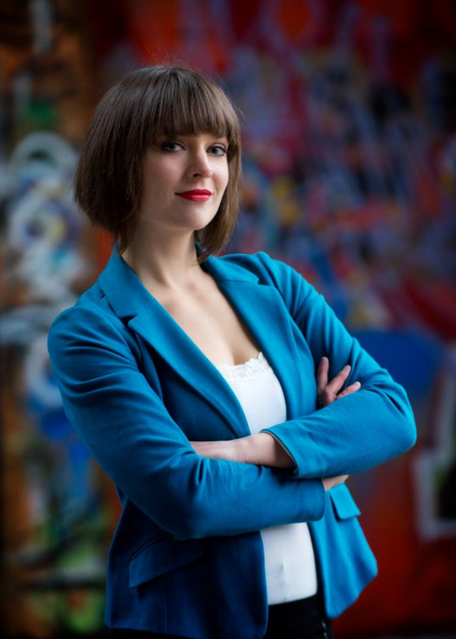
Cristina Haworth, AICP
EMPLOYER / Otak Inc., Senior Planner/ Project Manager
PLANNING FOCUS / Land use planning
MOST INTERESTING PROJECT AS A PLANNER / Metro South Base Expansion
EDUCATION / University of Pennsylvania, Master of City Planning; University of Washington, BA Community, Environment, and Planning
YEARS PLANNING / 7
WHY I PURSUED PLANNING AS A PROFESSION / Planning fits with my interest in problem-solving and serving the public good. I’m really drawn to resilience planning, especially as we consider climate change, sea level rise, and the dramatic effects these will have on our communities.
PAST WORK EXPERIENCE / Fairbanks North Star Borough, 2013-2014; Philadelphia City Planning Commission, 2011-2013

Slide 18
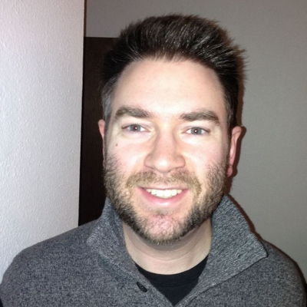
Jae Hill, AICP, CFM
EMPLOYER / City of Big Bear Lake, CA
(Planning Director)
PLANNING FOCUS / Long-Range Planning, Strategic Planning
MOST INTERESTING PROJECT AS A PLANNER /
Wrote the Multi-Jurisdiction Multi-Hazard Mitigation Plan for the Fairbanks North Star Borough in Alaska.
EDUCATION / Master of Urban and Regional Planning, Cal Poly Pomona; Master of Business Administration, University of Nevada Reno; Bachelor of Science in Geography, University of Utah
YEARS PLANNING / 13
WHY I PURSUED PLANNING AS A PROFESSION /
I’m passionate about mountain resort communities and climate change.
PAST WORK EXPERIENCE / Planning Director - Sun Valley ID; Deputy Planning Director – Fairbanks AK; Private water engineering consultant

Slide 19
Sandy Howard, AICP, LEED AP
EMPLOYER / Retired from City of Seattle, Construction and Inspections
PLANNING FOCUS / Green building sustainability, & preservation, new urbanism, equity in planning, and community resilience
MOST INTERESTING PROJECT AS A PLANNER / Old Poway Specific Plan
EDUCATION / Masters in City Planning
YEARS PLANNING / 25+
WHY I PURSUED PLANNING AS A PROFESSION / After living 3 years in Germany, I wanted to learn how cities work successfully and apply that knowledge to US urban centers
PAST WORK EXPERIENCE / Sustainable Strategist; Land Use Manager; Land Use Planner; Historic Preservation Planning; Biomedical Research

Slide 20
Paul Inghram,AICP
EMPLOYER / Puget Sound Regional Council
PLANNING FOCUS / Regional planning
MOST INTERESTING PROJECT AS A PLANNER / BelRed TOD subarea plan; Skykomish restoration plan
EDUCATION / UW, BA in Design and Planning (‘93); Seattle U, MBA (‘04); UVA (‘12)
YEARS PLANNING / 20+
WHY I PURSUED PLANNING AS A PROFESSION/ Initially, loved the design problem, then was turned on community engagement
PAST WORK EXPERIENCE / PSRC since 2016, City of Bellevue; previously consultant to various Puget Sound communities; some private development

Slide 21
Arun Jain, FAICP
EMPLOYER / City of Bellevue
PLANNING FOCUS / Decision support tools, methods and means to cope with complexity, uncertainty and urgency
MOST INTERESTING PROJECT AS A PLANNER /
EDUCATION / Urban Design Joint Degree Program 1985 (MCP, MArch) University of Pennsylvania, Philadelphia, PA, Architecture 1981 (BArch) School of Planning and Architecture, New Delhi, India
YEARS PLANNING / 32
WHY I PURSUED PLANNING AS A PROFESSION / To improve the quality of urban life for all, find beauty in chaos, and understand complexity in the natural and man-made environment from the lens of cognition and behavior
PAST WORK EXPERIENCE / International consultant, advisor, city executive, professor, researcher and mentor

Slide 22
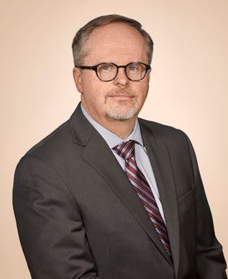
Mike Kattermann, AICP
EMPLOYER / City of Bothell
PLANNING FOCUS / community development, growth management, regional policy
MOST INTERESTING PROJECT AS A PLANNER / Creating neighborhood enhancement program; light rail best practices
EDUCATION / MS Community & Regional Planning, University of Texas at Austin; BS Urban Planning, Michigan State University
YEARS PLANNING / 30+
WHY I PURSUED PLANNING AS A PROFESSION/ Interest in cities as organic systems and how to influence that to improve peoples’ lives; variety of issues and challenges
PAST WORK EXPERIENCE / Public and private sector, mostly municipal and long range, entry-level to director; MI, TX, AZ, WA

Slide 23
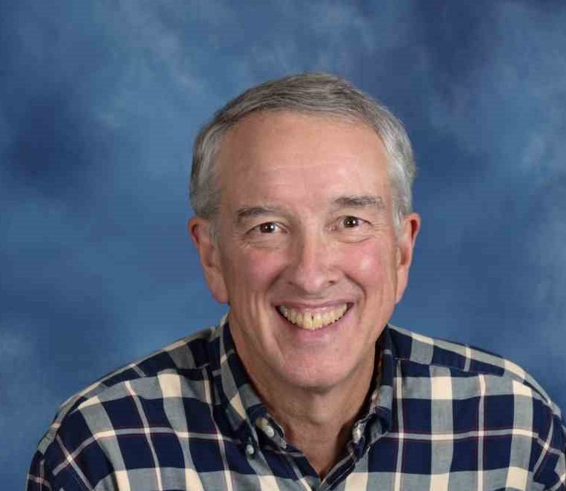
Rick Krochalis, AICP
EMPLOYER / Seattle Design Commission
PLANNING FOCUS / Environmental planning; transit systems development; capital project management; planning agency leadership
MOST INTERESTING PROJECT AS A PLANNER / Navy Base Master Plans; implementation of GMA; Columbia River Crossing
EDUCATION / Cornell University, BS in Environmental System Engineering; Harvard University, Masters, City & Regional Planning
YEARS PLANNING / Toom many to count; three career changes
WHY I PURSUED PLANNING AS A PROFESSION / Collaborating with people to have a direct influence on tangible urban design outcomes for many communities – one program and project at a time
PAST WORK EXPERIENCE / Regional Administrator (FTA); USDOT; City of Seattle, Director of Design, Construction, and Land Use (DCLU); Navy Civil Engineer Corps Officer

Slide 24
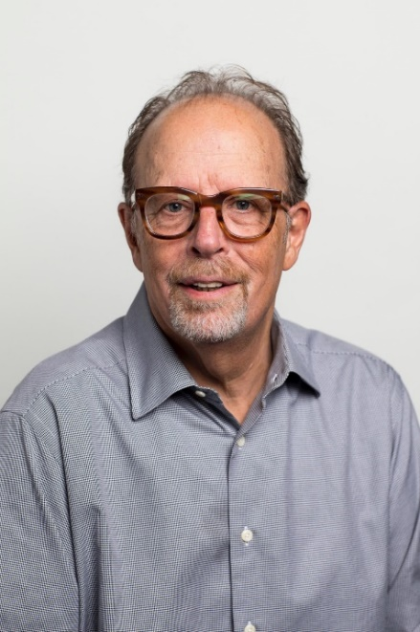
Al Levine
EMPLOYER / Affiliate Faculty, Runstad Department of Real Estate, CBE, UW; Formerly – Deputy Executive Director, Seattle Housing Authority (1998- 2013)
PLANNING FOCUS / Affordable housing, mixed income communities, transit-oriented development
MOST INTERESTING PROJECT AS A PLANNER / Yesler Terrace Redevelopment Project – Planning and Entitlements
EDUCATION / MUP UW: BA Hunter College, CUNY
YEARS PLANNING / 40+
WHY I PURSUED PLANNING AS A PROFESSION / I was always more interested in deciding where things went than what they looked like.
PAST WORK EXPERIENCE / My career has included opportunities in both the public and private sectors.

Slide 25
Patrick Lynch, AICP
EMPLOYER / Transpo Group
PLANNING FOCUS / Multimodal and non-motorized transportation, connectivity
MOST INTERESTING PROJECT AS A PLANNER / Statewide Human Services Transportation Plan; Pedestrian Connectivity Analyses for Small Communities
EDUCATION / Western Washington University, BS in Environmental Policy and Assessment
YEARS PLANNING / 17
WHY I PURUSED PLANNING AS A PROFESSION / Combining my passions for non-motorized transportation, public policy, and GIS in a way that positively impacts the local community.
PAST WORK EXPERIENCE / Transportation Planner; City of Woodinville

Slide 26
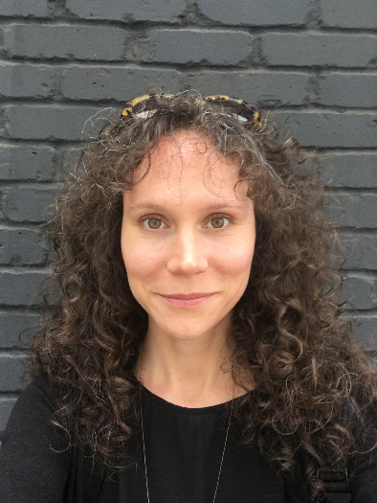
Cynthia McCoy, GISP
EMPLOYER / Federal Emergency Management Agency (FEMA) – Hazard Mitigation and Risk Analysis
PLANNING FOCUS / Urban design, GIS, hazard mapping and impact assessment, community engagement
MOST INTERESTING PROJECT AS A PLANNER / Developing flood hazard mapping, climate change impact analyses, and tribal relocation plan for the Village of Kotlik, AK and Kotlik Tribe
EDUCATION / Master of City and Regional Planning – University of Pennsylvania; Bachelor of Urban Planning – University of Cincinnati, OH
YEARS PLANNING / 17
WHY I PURSUED PLANNING AS A PROFESSION / To be an instrumental leader in developing healthy, resilient and equitable communities
PAST WORK EXPERIENCE / Wharton Real Estate Department – University of Pennsylvania, City of Covington KY – Community and Economic Development Dept., US Peace Corps Bulgaria (07-10), Bialosky + Partners Architects (Cleveland, OH), Walt Disney Imagineering

Slide 27
Rachel Miller
EMPLOYER / Senior Associate – Planner/Urban Designer; MAKERS Architecture and Urban Design
PLANNING FOCUS / Urban design
MOST INTERESTING PROJECT AS A PLANNER / Benson Hill Community Plan in Renton
EDUCATION / UW, MUP/ MLA; Ohio State University, BS in Architecture
YEARS PLANNING / 8
WHY I PURSUED PLANNING AS A PROFESSION / To improve spaces between buildings and empower communities to effect desired change.
PAST WORK EXPERIENCE / Peace Corps – Mali Volunteer; Downtown Association of Fairbanks and City of North Pole, AK Urban Design Coordinator; City of Columbus, OH Planning Intern

Slide 28
Ellen R. Miller-Wolfe
EMPLOYER / City of Kirkland
PLANNING FOCUS / Economic development, tourism, cultural affairs
MOST INTERESTING PROJECT AS A PLANNER / Riverfront Recapture, Inc., Hartford, CT (directed the redevelopment of 7-miles reach of Connecticut Riverfront through four cities)
EDUCATION / Skidmore College, BA; Cornell University, MRP
YEARS PLANNING / 28
WHYA I PURSUED PLANNING AS A PROFESSION / I was drawn to adaptive reuse and revitalization projects that engage community and incorporate community history and assets into efforts to address current issues.
PAST WORK EXPERIENCE / Public and private planning work; staff Seattle Landmarks Board, National Register of Historic Places; Riverfront Recapture, Inc., Economic Development staff; cities of Bellevue and Kirkland

Slide 29
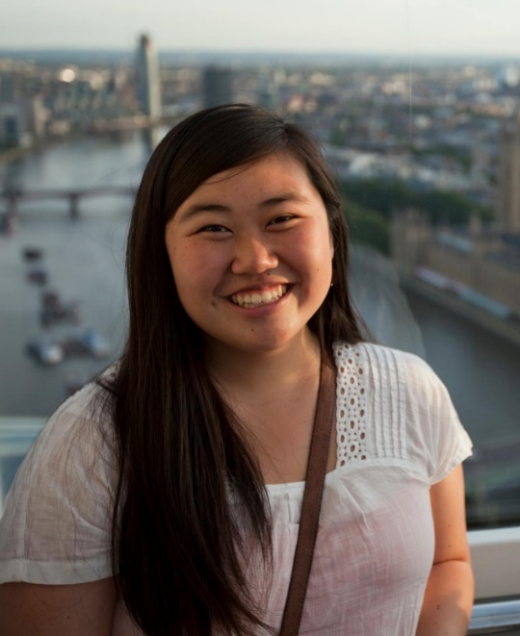
Lizzie Moll
EMPLOYER / Seattle Department of Transportation
PLANNING FOCUS / Transportation Planning
MOST INTERESTING PROJECT AS A PLANNER / Working on a multi-agency coordinated vision and near-term action plan for downtown Seattle
EDUCATION /
University of Washington, MUP (‘16) + Design Certificate
UMASS (‘12) Environmental Design, BS
YEARS PLANNING / 3
WHY I PURSUED PLANNING AS A PROFESSION / I’m interested in how cities and the urban form reflect the values of the folks with the most power. I see planning as a pathway to raise up community voices, empower others, and explore the intricacies of decision making.
PAST WORK EXPERIENCE /
Seattle Department of Transportation (2016 – present)
Seattle Public Utilities (2015 – 2016)
Center for Educational Software Development (2012-2014)

Slide 30
Ike Nwankwo
EMPLOYER / WA State Department of Commerce
PLANNING FOCUS / Growth Management Planning
MOST INTERESTING PROJECT AS A PLANNER / Development of the Housing Guidebook
EDUCATION / M.U.P Kansas, Ph.D. Candidate Univ. of Penn
YEARS PLANNING / 28
WHY I PURSUED PLANNING AS A PROFESSION / I have a Bachelor’s in Architecture and thought planning would be a good complement
PAST WORK EXPERIENCE / Worked for the Delaware River Port Authority, NJ

Slide 31
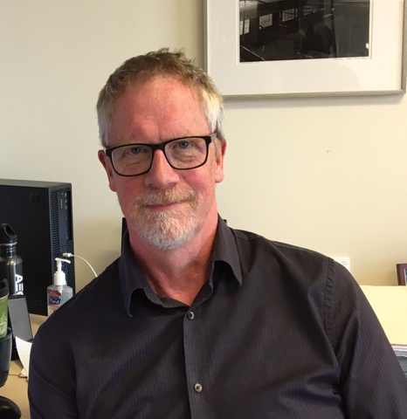
Kevin O’Neil, AICP
EMPLOYER /Senior Planning Manager at WSP
PLANNING FOCUS / Transportation Planning and policy, growth management, planning management
EDUCATION / BA University of Vermont; Masters degrees in City Planning and Public Adminstration, The Ohio State University
YEARS PLANNING / 33
WHY I PURSUED PLANNING AS A PROFESSION /Interest in cities and urban politics
PAST WORK EXPERIENCE / Cities of St. Louis(MO), Port Townsend, Kent, Bellevue, Seattle

Slide 32
John Owen
EMPLOYER / MAKERS Architecture and Urban Design
PLANNING FOCUS / Urban design, community and regional planning
EDUCATION / UW, MArch (‘75)
YEARS PLANNING / Too many
PAST WORK EXPERIENCE / Logging road surveyor, soils engineer, construction worker

Slide 33
Jack Peters
EMPLOYER / Director/ Community Planning & Development, HUD – WA Office
PLANNING FOCUS / Community Development, Housing and Environmental Planning
MOST INTERESTING PROJECT AS A PLANNER / International District Village Square 1 and 2, Seattle, WA
EDUCATION / UW, MUP (‘69)
YEARS PLANNING / 46
WHY I PURSUED PLANNING AS A PROFESSION / To revitalize communities and neighborhoods through encouraging comprehensive planning and by providing federal assistance
PAST WORK EXPERIENCE / City of Seattle Planning Department, City of Chicago, Ill Planning Department, City of Rockford Ill Planning Department, Bi-state Metropolitan Planning Commission Rock Island Ill

Slide 34
Mandi Roberts, AICP. RLA
EMPLOYER / Principal with Otak, Inc.
PLANNING FOCUS / Urban planning and design – including smart growth solutions, station area and subarea plans, corridor and streetscape planning, design guidelines and standards, and public space planning/ urban design
MOST INTERESTING PROJECT AS A PLANNER / Abu Dhabi Urban Street Design Manual; Hawaii Pedestrian Toolbox
EDUCATION / University of Idaho, Bachelors of Landscape Architecture; Portland State University, Graduate Coursework; Washington State University, Low Impact Development Certificate
YEARS PLANNING / 28
WHY I PURSUED PLANNING AS A PROFESSION / To help shape a more sustainable future and to improve the public realm by strengthening connections between people and places
PAST WORK EXPERIENCE / The Ferris Company; David Evans and Associates; City of Boise

Slide 35
Gwen Rousseau, AICP
EMPLOYER / City of Bellevue
PLANNING FOCUS / Demographics, Land Use, GIS Open Data
MOST INTERESTING PROJECT AS A PLANNER / Launching Bellevue’s Open Data portal
EDUCATION / University of Washington, MUP (‘05); Western Washington University, BS in Environment Science (‘03), Principia College, BA in English (‘89)
YEARS PLANNING / 15
WHY I PURSUED PLANNING AS A PROFESSION / To reinstate participatory democracy, save our planet and help make vibrant, caring communities
PAST WORK EXPERIENCE / AHBL, City of Buckley, WA Whatcom Transportation Authority

Slide 36
Katie Sheehy
EMPLOYER / Seattle Office of Planning and Community Development
PLANNING FOCUS / Equitable Development, Race and Social Justice
MOST INTERESTING PROJECT AS A PLANNER / Seattle Transit Communities, Equitable Development Initiative
EDUCATION / UW, MPA & MUP (2005); University of Portland BA in Philosophy
YEARS PLANNING / +10
WHY I PURSUED PLANNING AS A PROFESSION / Help improve government policy to better serve our communities and create a more equitable and sustainable society
PAST WORK EXPERIENCE / Seattle Planning Commission, Seattle, WA; Hewitt Architects, Seattle, WA; Alaska Department of Natural resources, Anchorage, AK

Slide 37
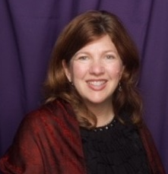
Janet Shull, AICP CUD
EMPLOYER / City of Seattle
PLANNING FOCUS / Urban design, community planning, sustainability, economic development and master planning
MOST INTERESTING PROJECT AS A PLANNER / Cities Putting Prevention to Work (CPPW) grant- funded planning for active and healthy communities including development of city’s first Bike/Ped master plan and regulations supporting urban agriculture
EDUCATION / University of Washington BA in Architecture; University of Washington graduate studies in Architecture and Urban Planning
YEARS PLANNING /29
WHY I PURSUED PLANNING AS A PROFESSION / I was most interested in how design of the built environment can help make places people love
PAST WORK EXPERIENCE /Senior Planner, City of Federal Way; Principal, Janet Shull Design; Project Manager, BWR; Planner, City of Kent.

Slide 38
Talia Tittelfitz, AICP
EMPLOYER / BHC Consultants, LLC
PLANNING FOCUS / Comprehensive Plans, sub area plans, current planning, code updates
MOST INTERESTING PROJECT AS A PLANNER / Assisting the Tulalip Tribes in a full scale re-organization of their zoning code
EDUCATION / UW, MUP (‘07)
YEARS PLANNING / 13
WHY I PURSUED PLANNING AS A PROFESSION / I like working in small to mid-sized communities where resources are focused and everyone knows a little bit about everything.
PAST WORK EXPERIENCE / Puget Sound Regional Council, Seattle; Wabash River Enhancement Corporation, Lafayette Indiana

Slide 39
Lisa Verner, FAICP
EMPLOYER / Retired and loving it (retired 6/18)
PLANNING FOCUS / Working with developers and local governments; policy development
MOST INTERESTING PORJECT AS A PLANNER / Development agreement between large landowner and City of Tukwila (Segale project)
EDUCATION / MSRED, MIT; MUP, Cal State San Jose; BA – Gov’t and Journalism, University of Redlands
YEARS PLANNING / 42
WHY I PURSUED PLANNING AS A PROFESSION / After working in a Congressman’s office reviewing a national land use bill, I wanted to know how cities were developed
PAST WORK EXPERIENCE / King County; My own consulting firm; Digital Equipment Corporation; Quadrant Corporation; City of Bothell; Triad Associates

Slide 40
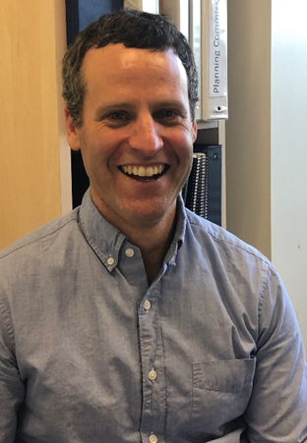
Adam Weinstein
EMPLOYER / City of Kirkland
PLANNING FOCUS / land use, sustainability, growth management, urban design, economic development, department administration/leadership
MOST INTERESTING PROJECT AS A PLANNER / I worked on legalizing bee keeping in a small city in the Bay Area – involving a lot of granular understanding of how bees (and beekeepers) operate
WHY I CHOSE PLANNING AS A PROFESSION / I love the intersection of politics and environmental protection, and the fact that cities are at the foundation of livability and sustainability
EDUCATION / University of California-Berkeley, MCP
University of Wisconsin-Madison, Bachelor of Science, Landscape Architecture and English Majors (2000)
YEARS PLANNING / 18
PAST WORK EXPERIENCE / Director of Planning and Building, City of Kirkland (2017-present); Deputy Director of Community Development, City of Pleasanton (2014-17); Principal, LSA Associates (2000-2014)

Slide 41
Julie West
EMPLOYER / Public Health – Seattle & King County
PLANNING FOCUS / Healthy community planning; integrating health and equity into local and regional planning projects and policies
MOST INTERESTING PROJECT AS A PLANNER / Yesler Terrace
Community Redevelopment (Seattle Housing Authority)
WHY I PURSUED PLANNING AS A PROFESSION / An opportunity to influence how our environments can support a healthy quality of life that our residents want for themselves, their families, and their communities
EDUCATION / BS; MPH
YEARS PLANNING / I’ve been with PHSKC for 15 years and began to focus on healthy planning approximately 10 years ago
PAST WORK EXPERIENCE / Registered Dietitian (Presbyterian Hospital, Albuquerque, NM); Peace Corps (Cote D’Ivoire, Africa); Program Manager (PHSKC, Seattle, WA)

Slide 42
Diane Wiatr, AICP
EMPLOYER / City of Seattle – Department of Transportation – Policy and Planning
PLANNING FOCUS / Active transportation planning with a healthy, whole communities’ approach and equity focus
MOST INTERESTING PROJECT AS A PLANNER / Developing the Prairie Line Trail in Tacoma through the University of WA Tacoma campus to the waterfront
WHY I CHOSE PLANNING AS A PROFESSION / An idealistic notion of creating better, more equitable, sustainable and welcoming urban environments and ways to get there. And I really like working with community to hear their views on the
city they would like to see.
EDUCATION / BA from Evergreen State College, MURP from University of Minnesota
YEARS PLANNING / 14
PAST WORK EXPERIENCE / Owned an independent, sustainably-oriented furniture store, then went to grad school to be an urban planner, worked at City of Tacoma for 10 years and have been at City of Seattle for 3 years. Seattle Housing Authority, Goodman Real Estate.

Slide 43
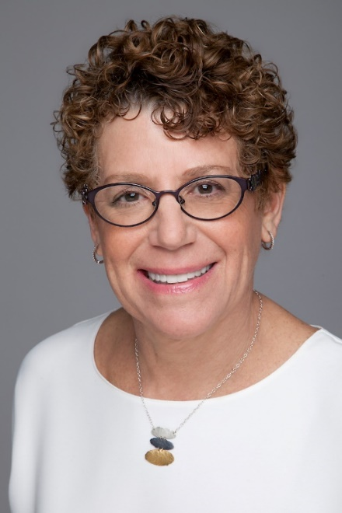
Karen Wolf, FAICP
EMPLOYER / King County, Senior Policy Analyst
PLANNING FOCUS / Regional and long-range planning; annexations
MOST INTERESTING PROJECT AS A PLANNER / Reducing growth rates in the rural area to less than 2% of total county growth
EDUCATION / UW, MUP, UW, BA in Economics
YEARS PLANNING / 25+
WHY I PURSUED PLANNING AS A PROFESSION / To shape and improve my surroundings
PAST WORK EXPERIENCE / King County since 1989 – including service as the land use advisor to King County Executive Ron Sims for seven years

Slide 44
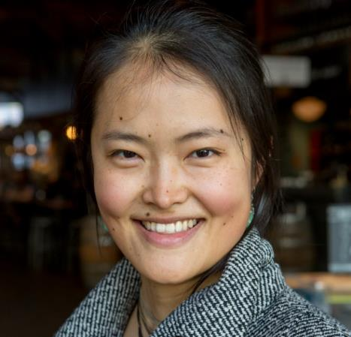
Boting (Bo) Zhang
EMPLOYER / City of Seattle Office of Planning and Community Development (Equitable Development Initiative)
PLANNING FOCUS / Socially responsive development
MOST INTERESTING PROJECT AS A PLANNER / Helping to grow an equitable development ecosystem
EDUCATION /MLA + real estate studies, UW; Comp Sci & Elec Eng, Yale
YEARS PLANNING / 8
WHY I PURSUED PLANNING AS A PROFESSION / Wanting to live in a world that’s less lonely.
PAST WORK EXPERIENCE / Beacon Development Group (Plaza Roberto Maestas & Pike Place Marketfront development projects); writing & facilitation-based art

