Slide 1

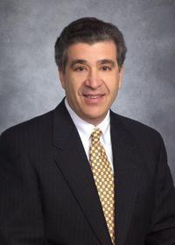
EMPLOYER / Montgomery Gulf Corporation
PLANNING FOCUS / Transit Oriented Development, Real Estate Development
MOST INTERESTING PROJECT AS A PLANNER /
Northgate Transit Oriented Development Project
EDUCATION / UW, MUP (’76); The Wharton School, University of Pennsylvania, BS in Economics (’74)
YEARS PLANNING / 39
WHY I PURSUED PLANNING AS A PROFESSION / As a
person interested in the built environment and land use, I found planning to be a good place to work in a variety of interesting settings.
PAST WORK EXPERIENCE / Nonprofit sector in affordable housing; Native American tribe in economic development

Slide 2
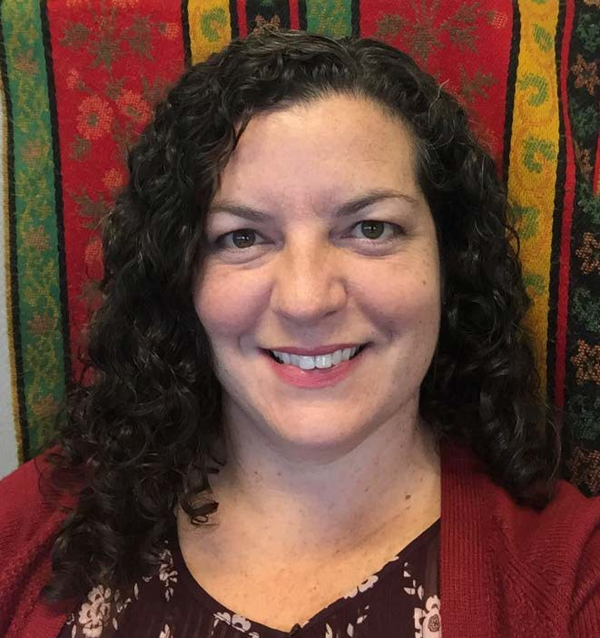
Shelley Bolser
EMPLOYER / City of Seattle Department of Construction and Inspections (SDCI)
PLANNING FOCUS / Urban design and current planning
MOST INTERESTING JOB AS A PLANNER /
Highrise apartment building in Seattle’s Denny Triangle, with the ground floor designed as a ‘third space’ for both residents and the public; buildings in the Pike Pine corridor of Seattle’s Capitol Hill that incorporated historic buildings into the new development
EDUCATION / UW, MUP and Urban Design Certificate (’03); UW, BA (’02)
YEARS PLANNING / 13
WHY I PURSUED PLANNING A S A CAREER/
Passionate about the potential for urban design to shape how we live together in cities. We need to create different spaces and buildings that encourage community, inspire people, allow for quiet reflection, and provide ecological function.
PAST WORK EXPERIENCE / Planner work in City of Seattle, Mercer Island, Kirkland, and some private sector consulting. Sewer and water maintenance in Kent and Kirkland

Slide 3

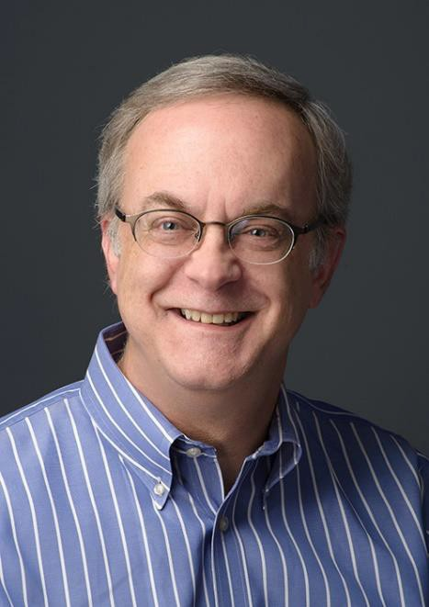
EMPLOYER / MRSC (Municipal Research & Services Center)
PLANNING FOCUS / Comprehensive and subarea planning, innovative implementation techniques (both regulatory and non- regulatory), urban design, and public engagement
MOST INTERESTING PROJECT AS A PLANNER / Station
area planning for two LRT stations in SeaTac; City of SeaTac/Sea-Tac Airport Interlocal Agreement; Cape Elizabeth (ME) Greenbelt Plan
EDUCATION / University of Wisconsin (Madison), MS in Urban & Regional Planning; St. Lawrence University (Canton, NY), BA in Sociology
YEARS PLANNING / 30+
WHY I PURSUED PLANNING AS A PROFESSION /
Combines a lot of my interests – improving the built environment, urban
design, and public engagement; Had a great undergraduate professor who got me interested in the field.
PAST WORK EXPERIENCE / City of Milwaukie, OR; City of Mill Creek; City of SeaTac; plus public and private sector planning with in Maine and Wisconsin

Slide 4

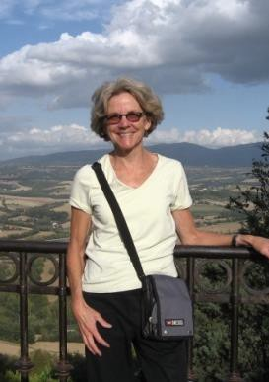
EMPLOYER / UW, Urban Design & Planning Affiliate Faculty; Curry Consulting
PLANNING FOCUS / Community planning, civic engagement, infrastructure planning, sustainability
MOST INTERESTING PROJECT AS A PLANNER /
Community visioning projects (e.g. Lake City); achieving community- city (and often student) partnerships
EDUCATION / UW, MUP; Indiana University, BA in Spanish and Political Science
YEARS PLANNING / 30+
WHY I PURSUED PLANNING AS A PROFESSION /
I strongly believe that planning, politics, and people are integral to creating a more balanced, sustainable community (The 3 P’s of planning).
PAST WORK EXPERIENCE / City of Seattle, Planning Commission Director; consulting with non-profits, foundations and local government; and of course teaching

Slide 5

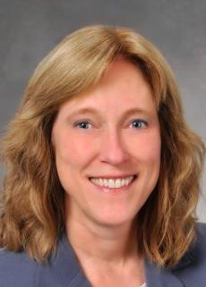
EMPLOYER / The Boeing Company (Land Use Planner for central Puget Sound)
PLANNING FOCUS / Liaison between Boeing and local governments’ projects and planning documents, and real estate items (easements, use agreements, etc.); (past) Comprehensive planning, health and the built environment.
MOST INTERESTING PROJECT AS A PLANNER / Too
many to say – the ones that are the most fun are the thorny ones that
generate strong opinions
EDUCATION / UW Masters Program (near-MUP), Macalester College, St. Paul, MN, BA in Geography
YEARS PLANNING / 25+
WHY I PURSUED PLANNING AS A PROFESSION /
I was a geography major and always loved knowing why people live where they do – what was special about those places. I wanted to be
part of shaping those decisions.
PAST WORK EXPERIENCE / The City of Puyallup; private consulting; Washington and Montana local government

Slide 6
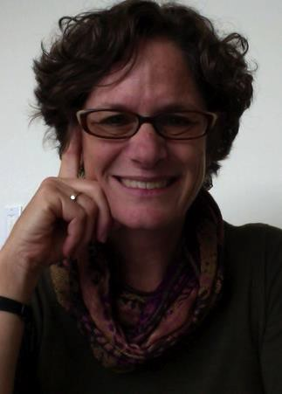
EMPLOYER / Washington Sea Grant
PLANNING FOCUS / Shoreline and Coastal Management
MOST INTERESTING PROJECT AS A PLANNER /
Currently developing LEED style program for Shoreline Certification
EDUCATION / MIT, MCP (‘86); Northeastern School of Law – JD (‘87); UW, BA in Political Science (‘81)
YEARS PLANNING / 25+
WHY I PURSUED PLANNING AS A PROFESSION /
I was interested in human interface with the environment and over the years that became human/built interface with the marine/shoreline environment.
PAST WORK EXPERIENCE / Reid Middleton (18 years); AECOM (1.5 years); 3 years in law (way back at the beginning…)

Slide 7

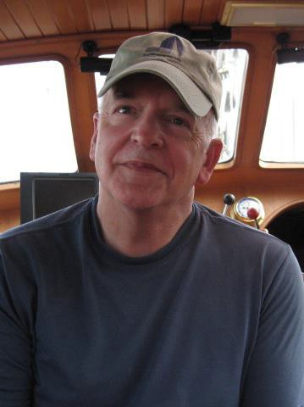
EMPLOYER / Eldred & Associates
PLANNING FOCUS / Land use planning, site location services, permitting, interagency coordination
MOST INTERESTING PROJECT AS A PLANNER / Trained
elected and appointed officials statewide during the years in
which I managed the state’s Short Course on Local Planning for DOC.
EDUCATION / UW, PhD (‘83); UW, MUP (‘81); Middlebury College, BA (‘69)
YEARS PLANNING / 30+
WHY I PURSUED PLANNING AS A PROFESSION /
Always interested in community development.
PAST WORK EXPERIENCE / Washington State DOC; Clallam County EDC; Samish Indian Nation; Shoalwater Bay Indian Tribe.

Slide 8

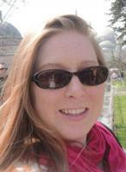
EMPLOYER / Seattle City Council
PLANNING FOCUS / Public policy, land use, economic development
MOST INTERESTING PROJECT AS A PLANNER /
Establishing Seattle’s Mandatory Housing Affordability program – the most complex and interesting project of my career.
EDUCATION / Georgia Tech, MUP (‘03); Emory University, BA in Business Administration
YEARS PLANNING / 14
WHY I PURSUED PLANNING AS A PROFESSION /
I grew up in the suburbs and always loved the excitement and diversity that cities offer and enjoy the wide range of critical issues that Planning grapples with, including sustainability, equity and
affordability.
PAST WORK EXPERIENCE / Futurewise; Bleakly Advisory Group

Slide 9
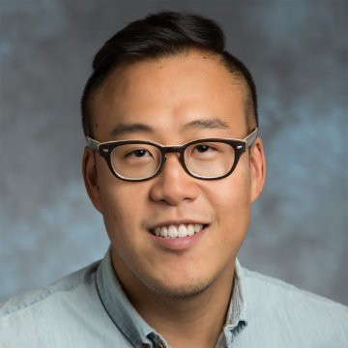
Ben Han
EMPLOYER / King County Metro
PLANNING FOCUS / Urban Design, Transportation Planning, Community Development
MOST INTERESTING PROJECT AS A PLANNER /
Community Liaison Program
EDUCATION / Maters City Planning, UC Berkeley ‘13. BA Community Environment and Planning UW ‘09
YEARS PLANNING / 4
WHY I PURSUED PLANNING AS A PROFESSION /
The mutual impact people and place have on each other
PAST WORK EXPERIENCE / City of Seattle, King County Metro, Pierce Transit

Slide 10

EMPLOYER / City of Seattle, Department of Planning and Development
PLANNING FOCUS / Development review, land use, green building and sustainable communities, emergency preparedness, New Urbanism (CNU Cascadia)
MOST INTERESTING PROJECT AS A PLANNER /
Old Poway Specific Plan
EDUCATION / Masters in City Planning
YEARS PLANNING / 20+
WHY I PURSUED PLANNING AS A PROFESSION / After
living 3 years in Germany, wanted to learn how cities work successfully and apply that knowledge to US urban centers.
PAST WORK EXPERIENCE / Sustainable Strategist; Land Use Manager; Land Use Planner; Historic Preservation Planning; Biomedical Research

Slide 11

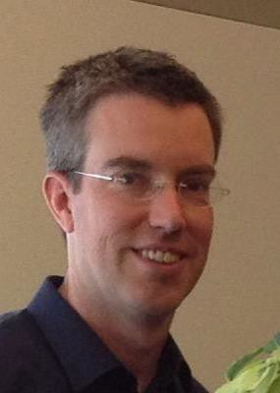
EMPLOYER / City of Bellevue, Comprehensive Planning Manager
PLANNING FOCUS / Community planning
MOST INTERESTING PROJECT AS A PLANNER /
BelRed TOD subarea plan; Skykomish restoration plan
EDUCATION / UW, BA in Design and Planning (’93); Seattle U, MBA (‘04); UVA (‘12)
YEARS PLANNING / 20+
WHY I PURSUED PLANNING AS A PROFESSION /
Initially, loved the design problem, then was turned on community engagement.
PAST WORK EXPERIENCE / Bellevue since 2006; previously consultant to various Puget Sound communities; some private development

Slide 12
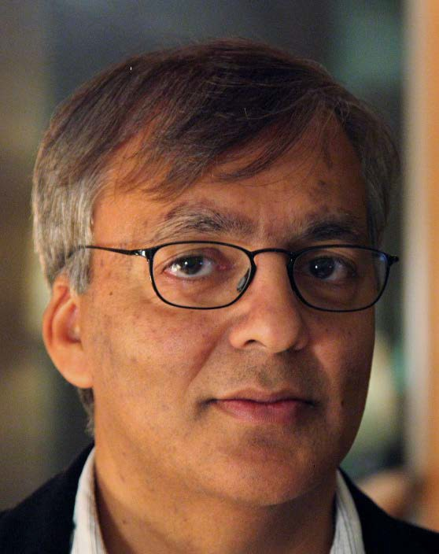
Arun Jain
EMPLOYER / Consultant
PLANNING FOCUS / Decision support tools, methods and means to cope with complexity, uncertainty and urgency.
MOST INTERESTING PROJECT AS A PLANNER /
EDUCATION / Urban Design Joint Degree Program 1985 (MCP, MArch) University of Pennsylvania, Philadelphia, PA, Architecture 1981 (BArch) School of Planning and Architecture, New Delhi, India
YEARS PLANNING / 32
WHY I PURSUED PLANNING AS A PROFESSION/
To improve the quality of urban life for all, find beauty in chaos, and understand complexity in the natural and man-made environment from the lens of cognition and behavior.
PAST WORK EXPERIENCE / International consultant, advisor, city executive, professor, researcher and mentor

Slide 13
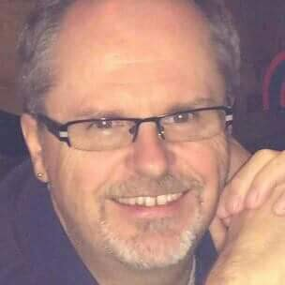
Michael Kattermann
EMPLOYER / City of Bellevue
PLANNING FOCUS / Long range planning and implementation, growth management, regional policy
MOST INTERESTING PROJECT AS A PLANNER /
Creating neighborhood enhancement program; light rail best practices
EDUCATION / MS Community & Regional Planning, University of Texas at Austin; BS Urban Planning, Michigan State University
YEARS PLANNING / 30
WHY I PURSUED PLANNING AS A PROFESSION /
Interest in cities as organic systems and how to influence that to improve peoples’ lives; variety of issues and challenges
PAST WORK EXPERIENCE / Public and private sector, mostly municipal and long range, entry-level to dept director; MI, TX, AZ, WA

Slide 14

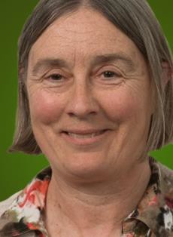
EMPLOYER / Semi-retired (formerly GeoEngineers)
PLANNING FOCUS / Infrastructure, climate change, energy, Environmental (SEPA/NEPA) Review
MOST INTERESTING PROJECT AS A PLANNER /
Changes every few years
EDUCATION / UW, BA in Urban Planning (‘70)
YEARS PLANNING / My entire career – always something new to learn!
WHY I PURSUED PLANNING AS A PROFESSION /
Enjoy multi-disciplinary decision making.
PAST WORK EXPERIENCE / Local government; consulting

Slide 15

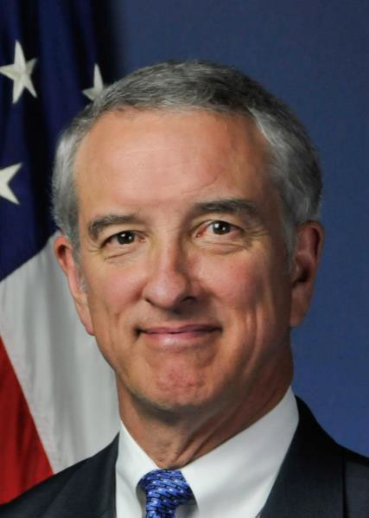
EMPLOYER / Seattle Design Commission
PLANNING FOCUS / Environmental planning; transit systems development; capital project management; planning agency leadership
MOST INTERESTING PROJECT AS A PLANNER / Navy
Base Master Plans; implementation of GMA; Columbia River Crossing
EDUCATION / Cornell University, BS in Environmental System Engineering; Harvard University, Masters, City & Regional Planning
YEARS PLANNING / Too many to count; three career changes
WHY I PURSUED PLANNING AS A PROFESSION /
Collaborating with people to have a direct influence on tangible urban design outcomes for many communities—one program
and project at a time.
PAST WORK EXPERIENCE / Regional Administrator (FTA); US DOT; City of Seattle, Director of Design, Construction, and Land Use (DCLU); Navy Civil Engineer Corps Officer

Slide 16

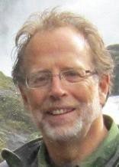
EMPLOYER / Affiliate Faculty, Department of Urban Design and Planning, UW; Formerly – Deputy Executive Director, Seattle Housing Authority (1998-2013)
PLANNING FOCUS / Affordable housing, mixed income communities, transit oriented development
MOST INTERESTING PROJECT AS A PLANNER / Yesler
Terrace
Redevelopment Project – Planning and Entitlements Process
EDUCATION / Hunter College; City University of NY, BA; UW, MUP
YEARS PLANNING / 40+
WHY I PURSUED PLANNING AS A PROFESSION /
Wanted to be the one who decided where things went.
PAST WORK EXPERIENCE / My career has included opportunities in both the public and private sectors.

Slide 17

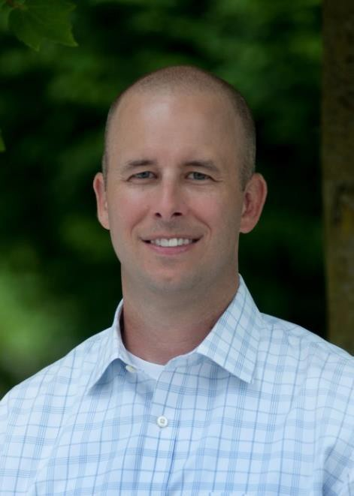
EMPLOYER / Transpo Group
PLANNING FOCUS / Multimodal and non-motorized transportation, connectivity
MOST INTERESTING PROJECT AS A PLANNER /
Statewide Human Services Transportation Plan; Pedestrian Connectivity Analyses for Small Communities
EDUCATION / Western Washington University, BS in Environmental Policy and Assessment
YEARS PLANNING / 17
WHY I PURSUED PLANNING AS A PROFESSION /
Combining my passions for non-motorized transportation, public policy, and GIS in a way that positively impacts the local community.
PAST WORK EXPERIENCE / Transportation Planner, City of Woodinville

Slide 18

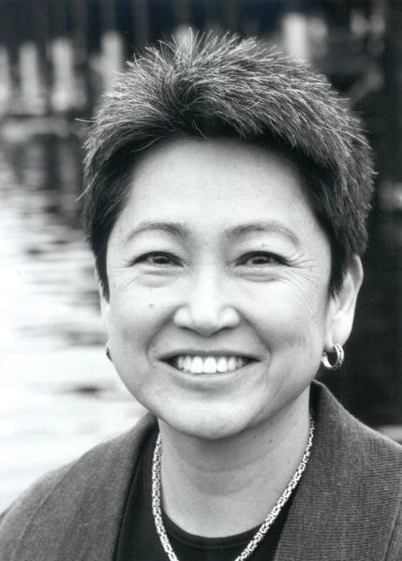
EMPLOYER / UW Green Futures Lab Regional Open Space Strategy
PLANNING FOCUS / Environmental, land use, sustainability planning and policy
MOST INTERESTING PROJECT AS A PLANNER /
Tri-County Model Salmon Conservation Plan
EDUCATION / MLA; BLA; BAUP
YEARS PLANNING / 30+
WHY I PURSUED PLANNING AS A PROFESSION /
A hike up to Emmons Glacier, Mt. Rainier, my sophomore year of high school inspired by focus on sustainable human/environment interaction.
PAST WORK EXPERIENCE / Environmental Science Associates; King County Executive Office; DDES; CH2M Hill; Seattle OLP/DCLU

Slide 19

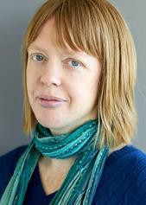
EMPLOYER / BERK Consulting
PLANNING FOCUS / Comprehensive plans, community engagement, public policy
MOST INTERESTING PROJECT AS A PLANNER /
Seattle Restricted Parking Zone policy review
EDUCATION / UW, MUP (‘14); UW, Sustainable Transportation Certificate (‘10); Western Washington University, BA in Political Science (‘98)
YEARS PLANNING / 7
WHY I PURSUED PLANNING AS A PROFESSION /
I love cities and I love bringing people together to solve community problems.
PAST WORK EXPERIENCE / UW Transportation Services, Zipcar, Sierra Club, Duwamish Transportation Management Association

Slide 20
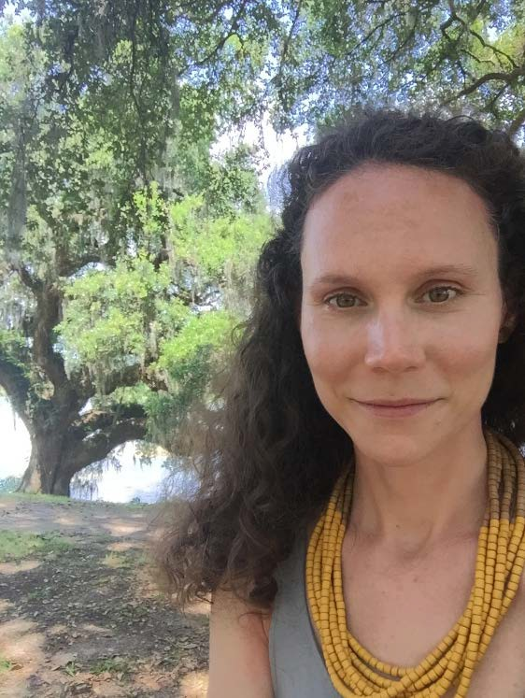
Cynthia McCoy, GISP
EMPLOYER / Federal Emergency Management Agency (FEMA) – Hazard Mitigation and Risk Analysis
PLANNING FOCUS / Urban design, GIS, hazard mapping and impact assessment, community engagement.
MOST INTERESTING PROJECT AS A PLANNER /
Establishing a community center for a marginalized Roma Community in Karlovo, Bulgaria
EDUCATION / Master of City and Regional Planning – University of Pennsylvania; Bachelor of Urban Planning – University of Cincinnati, OH
YEARS PLANNING / 15
WHY I PURSUED PLANNING AS A PROFESSION / To be
an instrumental leader in developing healthy, resilient and equitable communities.
PAST WORK EXPERIENCE / Wharton Real Estate Department – University of Pennsylvania, City of Covington KY – Community and Economic Development Dept., US Peace Corps Bulgaria (07-10), Bialosky
+ Partners Architects (Cleveland, OH), Walt Disney Imagineering

Slide 21

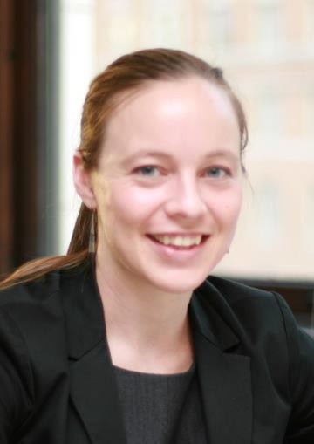
EMPLOYER / Senior Associate - Planner/Urban Designer, MAKERS Architecture and Urban Design
PLANNING FOCUS / Urban design
MOST INTERESTING PROJECT AS A PLANNER /
Benson Hill Community Plan in Renton
EDUCATION / UW, MUP/MLA; Ohio State University, BS in Architecture
YEARS PLANNING / 8
WHY I PURSUED PLANNING AS A PROFESSION / To
improve spaces between buildings and empower communities to effect desired change.
PAST WORK EXPERIENCE / Peace Corps – Mali Volunteer; Downtown Association of Fairbanks and City of North Pole, AK Urban Design Coordinator; City of Columbus, OH Planning Intern

Slide 22



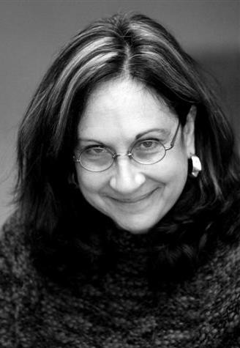
EMPLOYER / City of Kirkland
PLANNING FOCUS / Economic development, tourism, cultural affairs
MOST INTERESTING PROJECT AS A PLANNER /
Riverfront Recapture, Inc., Hartford, CT (Directed the redevelopment of 7- miles reach of Connecticut Riverfront through four cities)
EDUCATION / Skidmore College, BA; Cornell University, MRP
YEARS PLANNING / 28
WHY I PURSUED PLANNING AS A PROFESSION /
I was drawn to adaptive reuse and revitalization projects that engage community and incorporate community history and assets into efforts to address current issues.
PAST WORK EXPERIENCE / Public and private planning work; staff Seattle Landmarks Board, National Register of Historic Places; Riverfront Recapture, Inc., Economic Development staff; cities of Bellevue and Kirkland

Slide 23

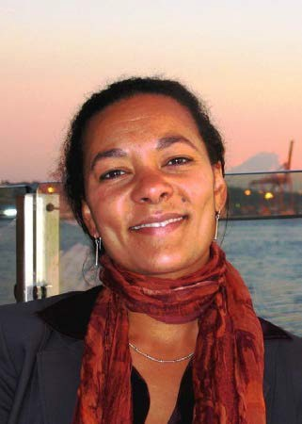
EMPLOYER / Principal/Founder Lotus Development Partners LLC
PLANNING FOCUS / Community and economic development, affordable housing
MOST INTERESTING PROJECT AS A PLANNER /
Renovation of a commercial fishing dock on the Makah Reservation in Neah Bay, WA.
EDUCATION / University of Michigan, Masters Urban Planning/Masters Social Work
YEARS PLANNING / 25
WHY I PURSUED PLANNING AS A PROFESSION /
Planning is a wide-ranging field that touches on all aspects of creating a livable environment and healthy community.
PAST WORK EXPERIENCE / Development of affordable housing and community facilities for nonprofit organizations; current planning for City and County governments in Washington

Slide 24
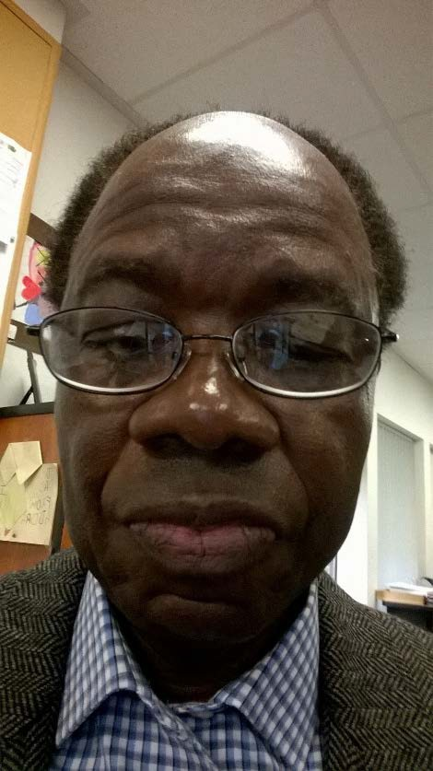
Ike Nwankwo
EMPLOYER / WA State Department of Commerce
PLANNING FOCUS / Growth Management Planning
MOST INTERESTING PROJECT AS A PLANNER/
Development of the Housing Guidebook
EDUCATION / M.U.P Kansas, Ph.D. Candidate Univ. of Penn
YEARS PLANNING / 28
WHY I PURSUED PLANNING AS A PROFESSION / I have a
Bachelor’s in Architecture and thought planning would be a good complement
PAST WORK EXPERIENCE / Worked for the Delaware River Port Authority, NJ

Slide 25

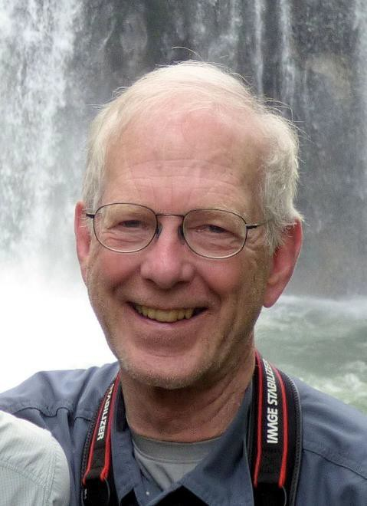
EMPLOYER / MAKERS Architecture and Urban Design
PLANNING FOCUS / Urban design, community and regional planning, shoreline management
EDUCATION / UW, MUP (‘75)
YEARS PLANNING / Too many
PAST WORK EXPERIENCE / Logging road surveyor, soils engineer, construction worker

Slide 26

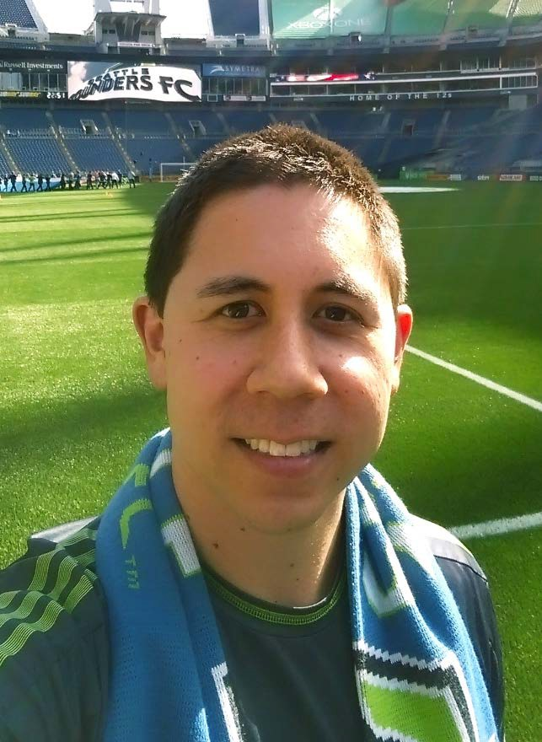
EMPLOYER / City of Kirkland
PLANNING FOCUS / Sustainable transportation planning, public policy, equity and urban design.
EDUCATION / UW, BA in Geography (‘08); UW, MUP (‘13)
YEARS PLANNING / 8
WHY I PURSUED PLANNING AS A PROFESSION /
Planning allows me to engage diverse communities and guide sustainable transport options in order to preserve our natural environment.
PAST WORK EXPERIENCE / City of Redmond Public Works; Seattle Department of Transportation; Kitsap County Public Works

Slide 27

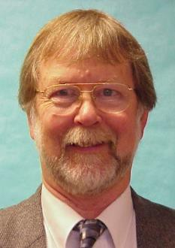
EMPLOYER / Director/Community Planning & Development, HUD – WA Office
PLANNING FOCUS / Community Development, Housing and Environmental Planning
MOST INTERESTING PROJECT AS A PLANNER /
International District Village Square 1 and 2, Seattle, WA
EDUCATION / UW, MUP (‘69)
YEARS PLANNING / 46
WHY I PURSUED PLANNING AS A PROFESSION /
To revitalize communities and neighborhoods trough encouraging comprehensive planning and by providing federal assistance.
PAST WORK EXPERIENCE / City of Seattle Planning Department, City of Chicago, Ill Planning Department, City of Rockford Ill Planning Department, Bi-State Metropolitan Planning Commission Rock Island III.

Slide 28

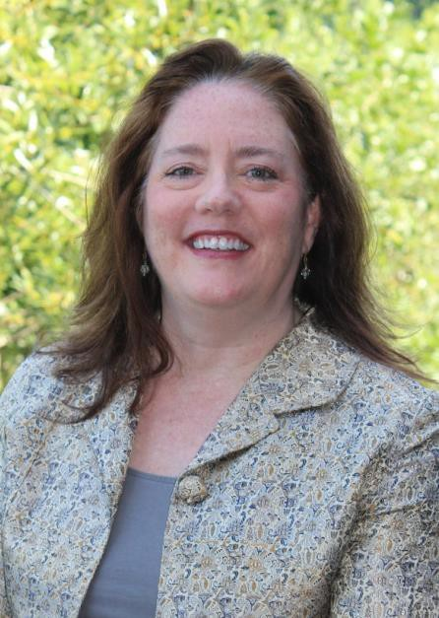
EMPLOYER / Principal with Otak, Inc.
PLANNING FOCUS / Urban planning and design – including smart growth solutions, station area and subarea plans, corridor and streetscape planning, design guidelines and standards, and public space planning/urban design
MOST INTERESTING PROJECT AS A PLANNER / Abu
Dhabi Urban Street Design Manual; Hawaii Pedestrian Toolbox
EDUCATION / University of Idaho, Bachelors of Landscape Architecture; Portland State University, Graduate Coursework; Washington State University, Low Impact Development Certificate
YEARS PLANNING / 28
WHY I PURSUED PLANNING AS A PROFESSION / To
help shape a more sustainable future and to improve the public realm by strengthening connections between people and places.
PAST WORK EXPERIENCE / The Ferris Company; David Evans and Associates; City of Boise, Idaho

Slide 29
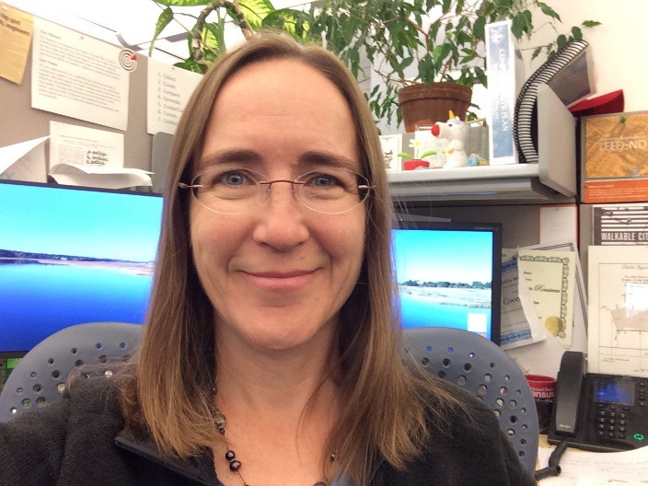
Gwen Rousseau
EMPLOYER / City of Bellevue
PLANNING FOCUS / Demographics, Land Use, GIS Open Data
MOST INTERESTING PROJECT AS A PLANNER /
Launching Bellevue's Open Data portal
EDUCATION / University of Washington, MUP('05); Western Washington University, BS in Environment Science ('03), Principia College, BA in English ('89)
YEARS PLANNING / 15
WHY I PURSUED PLANNING AS A PROFESSION / To
reinstate participatory democracy, save our planet and help make vibrant, caring communities.
PAST WORK EXPERIENCE / AHBL, City of Buckley, WA,
Whatcom Transportation Authority

Slide 30
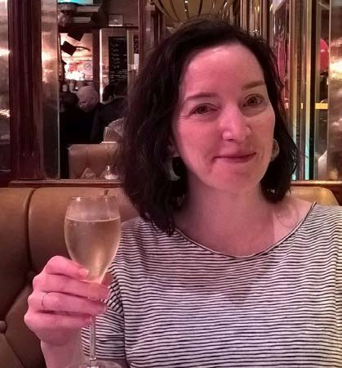
Katie Sheehy
EMPLOYER / Seattle Office of Planning and Community Development
PLANNING FOCUS / Equitable Development, Race and Social Justice
MOST INTERESTING PROJECT AS A PLANNER / Seattle
Transit Communities, Equitable Development Initiative
EDUCATION / UW, MPA & MUP (2005); University of Portland BA in Philosophy
YEARS PLANNING / 10+
WHY I PURSUED PLANNING AS A PROFESSION / Help
improve government policy to better serve our communities and create a more equitable and sustainable society
PAST WORK EXPERIENCE / Seattle Planning Commission, Seattle, WA; Hewitt Architects, Seattle, WA; Alaska Department of Natural Resources, Anchorage, AK

Slide 31

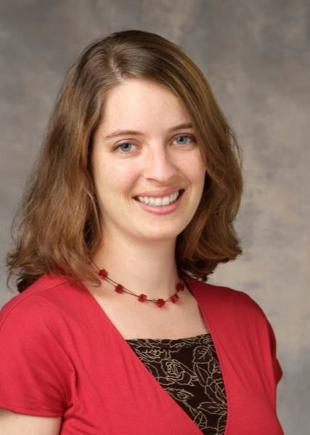
EMPLOYER / BHC Consultants, LLC
PLANNING FOCUS / Comprehensive Plans, sub area plans, current planning, population forecast
MOST INTERESTING PROJECT AS A PLANNER /
Population forecasts to support sewer infrastructure modeling in a UGA Remand case in Kitsap County.
EDUCATION / UW, MUP (‘07)
YEARS PLANNING / 10+
WHY I PURSUED PLANNING AS A PROFESSION /
I like working in small to mid-sized communities where resources are focused and everyone knows a little bit about everything.
PAST WORK EXPERIENCE / Puget Sound Regional Council, Seattle; Wabash River Enhancement Corporation, Lafayette Indiana

Slide 32

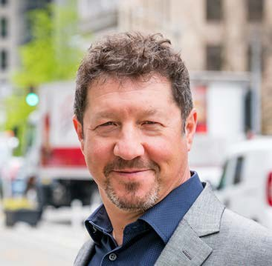
EMPLOYER / DKS Associates
PLANNING FOCUS / Transportation and Environmental sustainability
MOST INTERESTING PROJECT AS A PLANNER /
Autonomous Vehicle study, Sand Point reuse, Rosario Resort Master Plan, Hurricane Katrina recovery
EDUCATION / UW, MUP (‘04), UVM, BA in Environmental Studies (‘86)
YEARS PLANNING / 25
WHY I PURSUED PLANNING AS A PROFESSION /
Match for my interests, skills, personality & commitment to the environment
PAST WORK EXPERIENCE / AECOM, Metro Transit, SE Group, EDAW, City of Seattle

Slide 33
Lisa Verner, FAICP
EMPLOYER / King County
PLANNING FOCUS / Working with developers and local governments
MOST INTERESTING PROJECT AS A PLANNER /
Development agreement between large landowner and City of Tukwila (Segale project)
EDUCATION / MSRED, MIT; MUP, Cal State San Jose; BA – Gov’t and Journalism, University of Redlands
YEARS PLANNING / 40
WHY I PURSUED PLANNING AS A PROFESSION /
I wanted to know how cities came about
PAST WORK EXPERIENCE / My own consulting firm; Digital Equipment Corporation; Quadrant Corporation; City of Bothell; Triad Associates

Slide 34

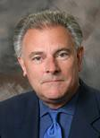
EMPLOYER / Part-time at BHC Consultants, LLC
PLANNING FOCUS / Comprehensive plans, economic development, implementation
MOST INTERESTING JOB AS A PLANNER / Statewide study of housing needs for Alaskan Native peoples
WHY I CHOSE PLANNING AS A PROFESSION / Coming from
Architecture, I was interested in the “pre-design” decisions about site location & planning, public information, etc.
EDUCATION / UW, MUP (‘70), University of Nebraska, B Arch (‘66)
YEARS PLANNING / 50
PAST WORK EXPERIENCE / NBBJ, DEA, Leo A. Daly Co.

Slide 35
Julie West
EMPLOYER / Public Health – Seattle & King County
PLANNING FOCUS / Healthy community planning; integrating health and equity into local and regional planning projects and policies
MOST INTERESTING JOB AS A PLANNER / Yesler Terrace
Community Redevelopment (Seattle Housing Authority)
WHY I CHOSE PLANNING AS A PROFESSION / An opportunity to influence how our environments can support a healthy quality of life that our residents want for themselves, their families, and their communities
EDUCATION / BS; MPH
YEARS PLANNING / I’ve been with PHSKC for 15 years and began to focus on healthy planning approximately 10 years ago
PAST WORK EXPERIENCE / Registered Dietitian (Presbyterian Hospital, Albuquerque, NM); Peace Corps (Cote D’Ivoire, Africa); Program Manager (PHSKC, Seattle, WA)

Slide 36

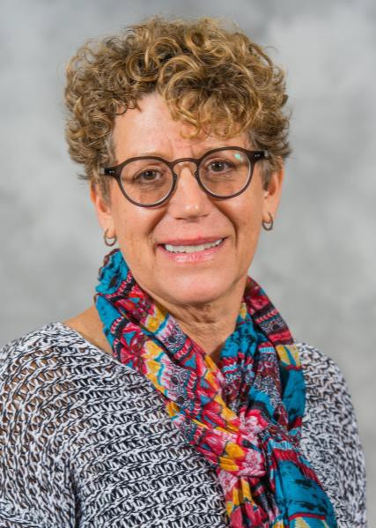
EMPLOYER / King County, Senior Policy Analyst
PLANNING FOCUS / Regional and long-range planning; annexations
MOST INTERESTING PROJECT AS A PLANNER /
Reducing
growth rates in the rural area to less than 2% of total county growth
EDUCATION / UW, MUP; UW, BA in Economics
YEARS PLANNING / 25+
WHY I PURSUED PLANNING AS A PROFESSION /
To shape and improve my surroundings.
PAST WORK EXPERIENCE / King County since 1989 – including service as the land use advisor to King County Executive Ron Sims for seven years.

